Slide 1
Simple Calculator Using Python Program
Presented By Vivek Rajput

Slide 2
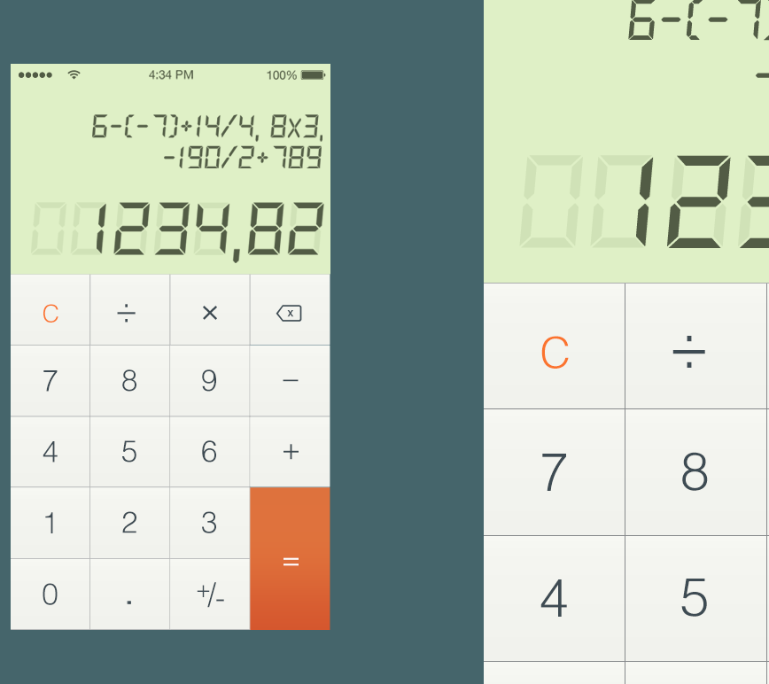
Introduction
A simple calculator program using tkinter.
Built using Python programming language.
Provides basic arithmetic operations.

Slide 3
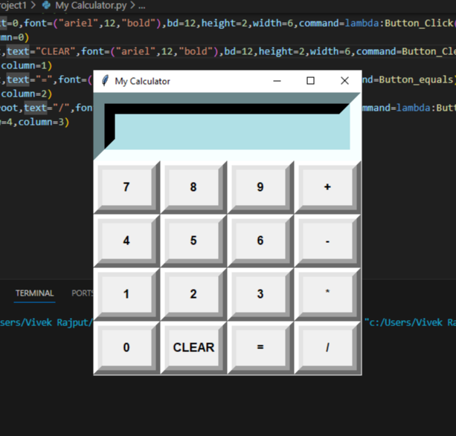
User Interface
The calculator has a clean and user-friendly interface.
Consists of buttons for numbers and operators.
Includes an entry field for input and display.

Slide 4
Functionality
The calculator supports addition, subtraction, multiplication, and division.
It can perform calculations on both integers and floating-point numbers.
Implements basic error handling for division by zero.
Users can enter numbers by clicking the corresponding buttons or typing on the keyboard.
The calculator displays the input and the result in the entry field.
Clear button resets the input and output.

Slide 5
Code Structure
The program follows a modular approach with separate functions for different operations.
Uses the tkinter library for creating the graphical user interface.
Utilizes event-driven programming for handling button clicks.

Slide 6
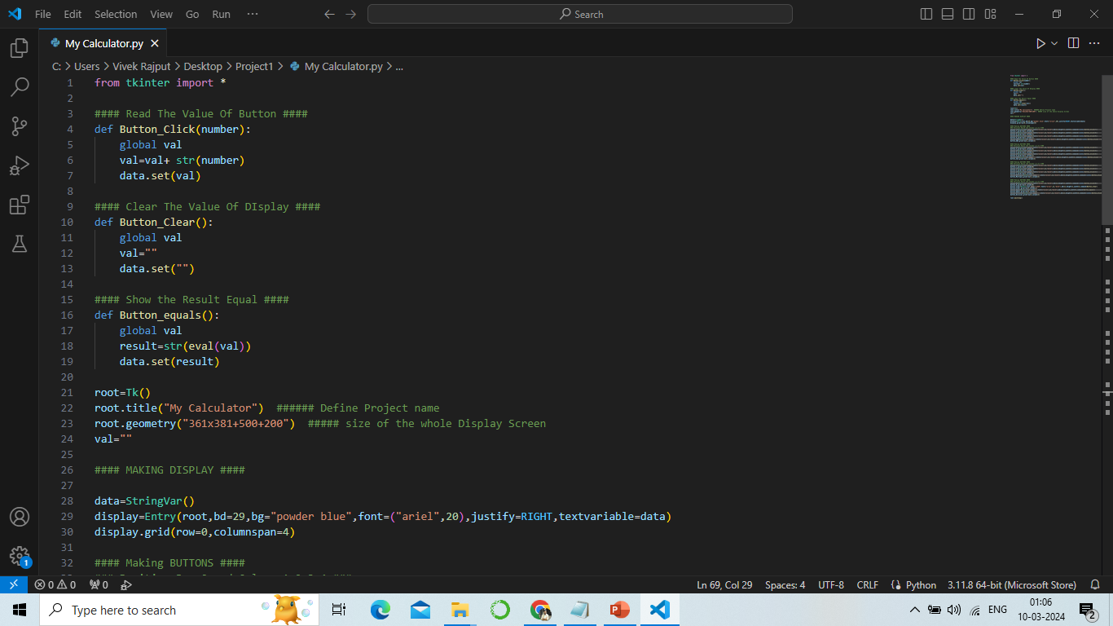

Slide 7
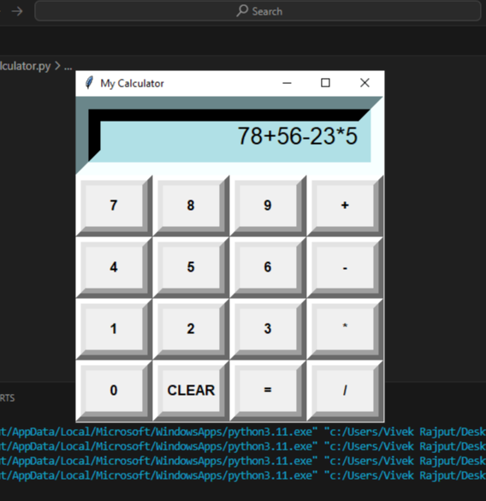
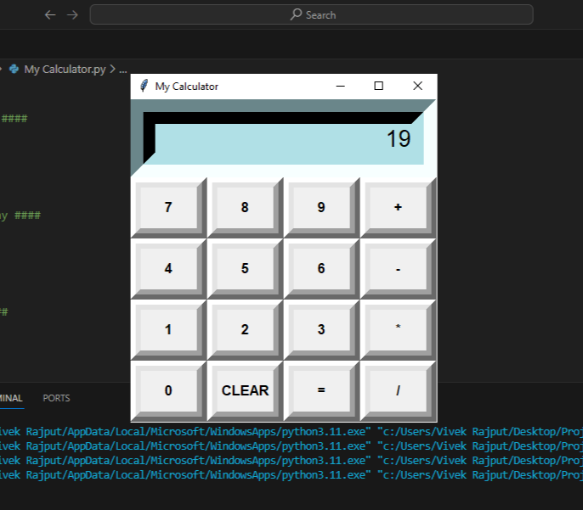
Outputs

Slide 8
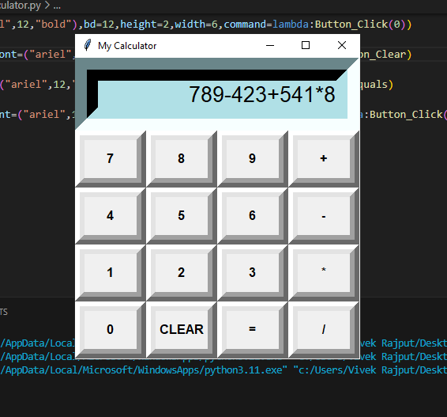
Conclusion
A simple calculator program built with tkinter.
Provides basic arithmetic operations with a user-friendly interface.
Customizable and can be extended with additional features if desired.

Slide 9
Thank You

